Slide 1
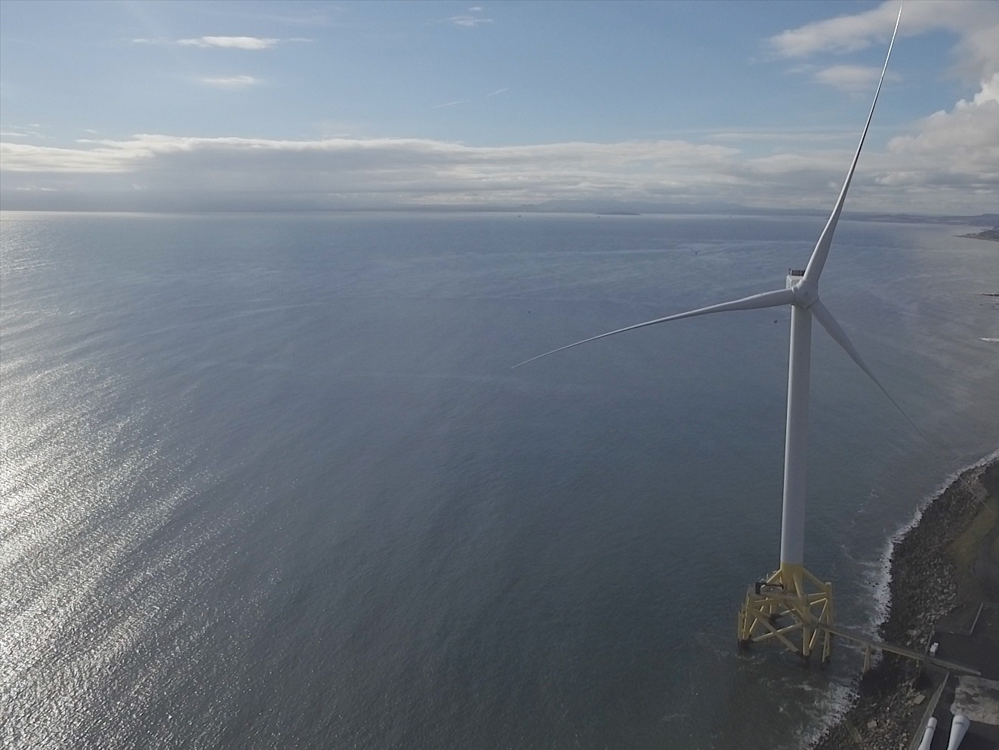

Blade Erosion Performance Impact
Owen Murphy – Project Engineer
13th December 2016

Slide 2
Introduction to ORE Catapult
Introduction to Blade Erosion
Current situation
How to quantify the cost of energy impact
Our initial findings
Opportunities to improve decision making
Future work
Wider research
Questions

Slide 3
Introduction to ORE Catapult

Slide 4

Our Delivery

Slide 5
Introduction to Blade Erosion

Slide 6
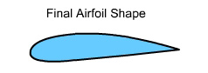
What is blade erosion?
Wind turbine blades move through the air at high speed
They encounter rain, hail, and particulates
The impact of droplets or particulates damages blade coatings
Over time the surface of blades (particularly leading edges) are observed to erode or wear away
There are analogies to aerospace and marine applications where erosion is significant
Trailing edge
Leading edge
Flow

Slide 7
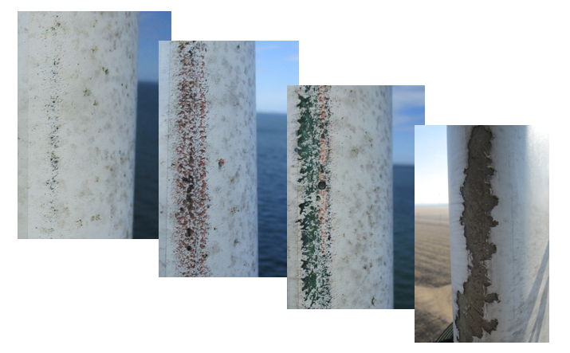
What does blade erosion look like?
Erosion of leading edge of wind turbine blades has been widely reported
Has been observed in even short (~ 5 years) operational life

Slide 8
The current situation

Slide 9

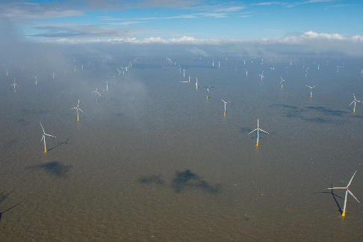
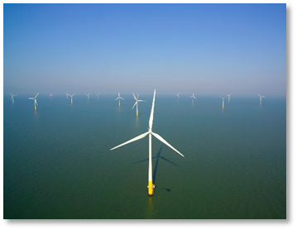
Industry engagement
Catapult conducted extensive industry engagement
All operators appear to be aware of erosion
Variety of strategies for inspection, repair, management
A general agreement that there is a lack of understanding of the phenomena

Slide 10
Cost benefit understanding
Supply chain
Unknown
Operators

Slide 11
How to quantify cost of energy impact?

Slide 12

Overview of methodology
A variety of ways to approach the challenge of erosion yield impact
Our first project shaped around using lidar power performance assessment before and after repair of blades
Compliments other ways to establish performance impact of erosion
Performance pre repair ~2-3 months
Repair ~2-5 days
Performance post repair ~3-4 months

Slide 13
Measurement campaign timeline
Phase 1 Measurements
(Jul – Oct 2015)
Phase 1
interim analysis report (Dec 2015)
Phase 2 Measurements
(Oct - Feb 2016)
Comparative analysis report
(Q2 2016)

Slide 14
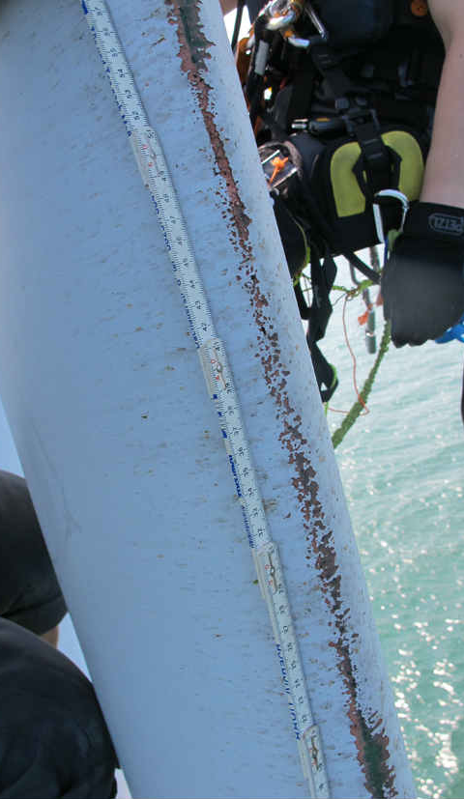
Campaign Motivation and Design
Knowing what we do about erosion we set out to quantify benefit of repairs
Cost of inspection and repair is known
Cost of lost yield is not known
Few public existing field measurements which may struggle for credibility
Important to conduct a campaign which isolates effect of erosion from other factors
Striving for balance of achievable campaign and low uncertainty

Slide 15
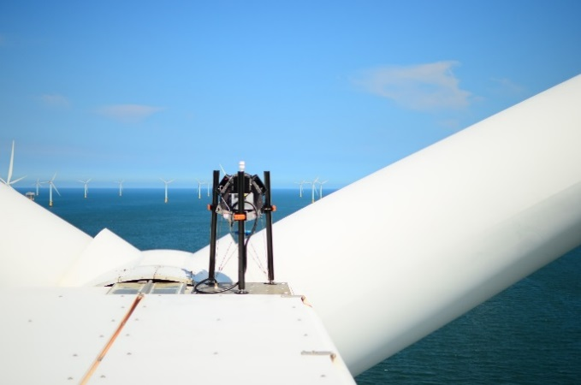
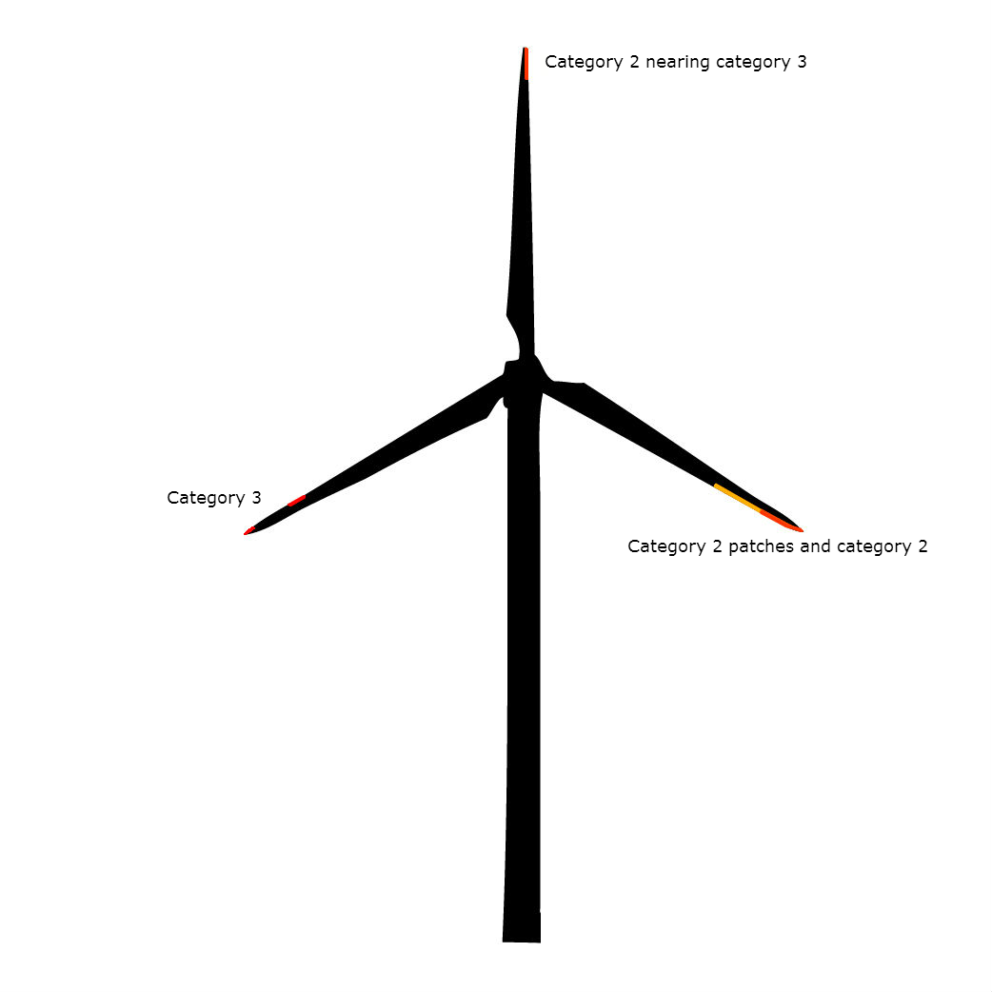
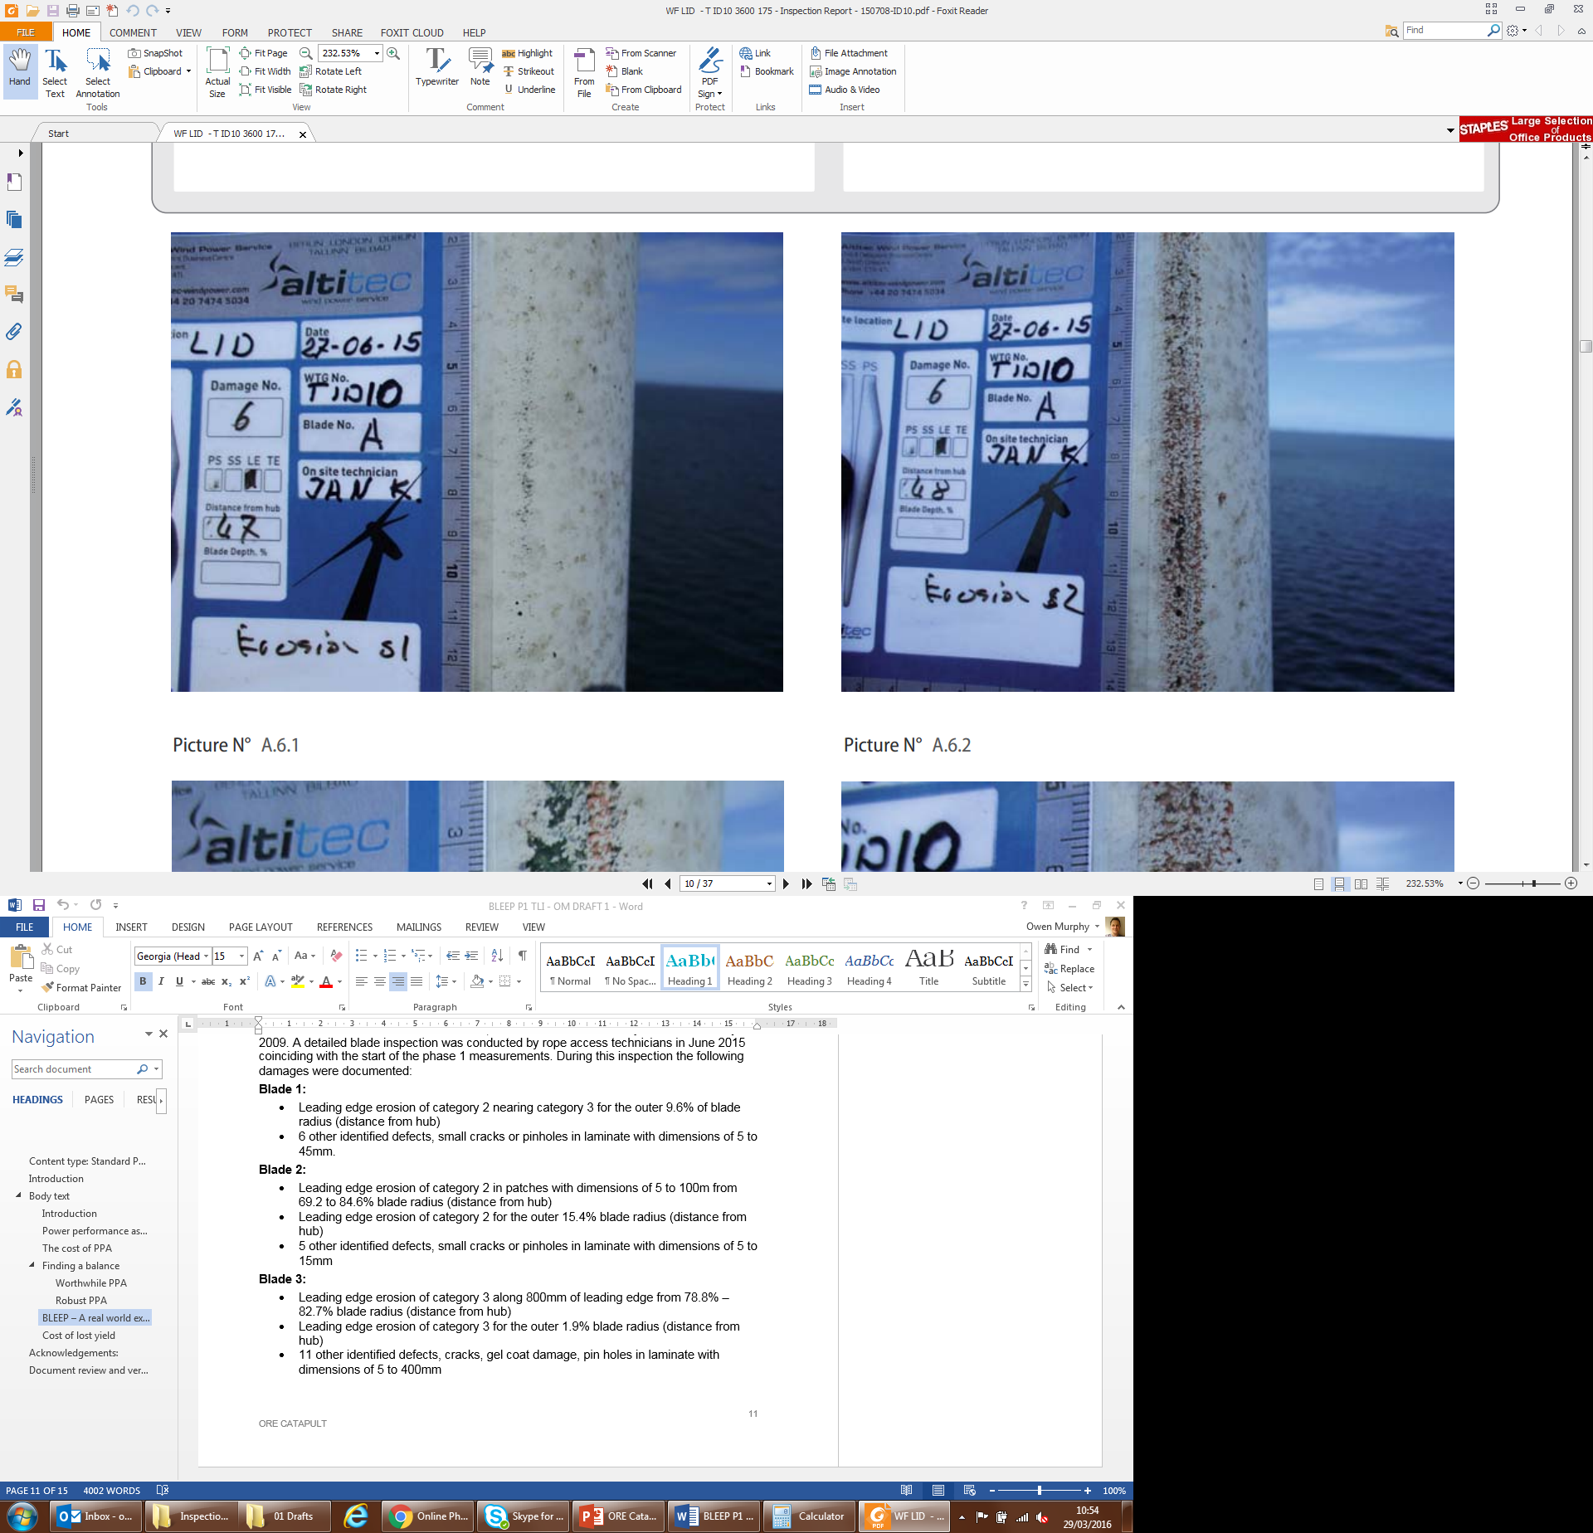
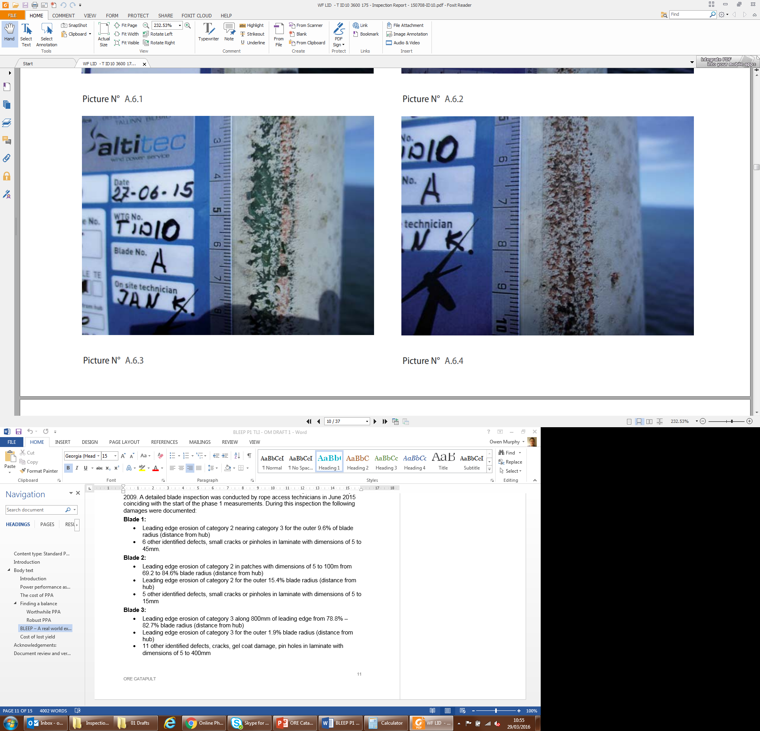
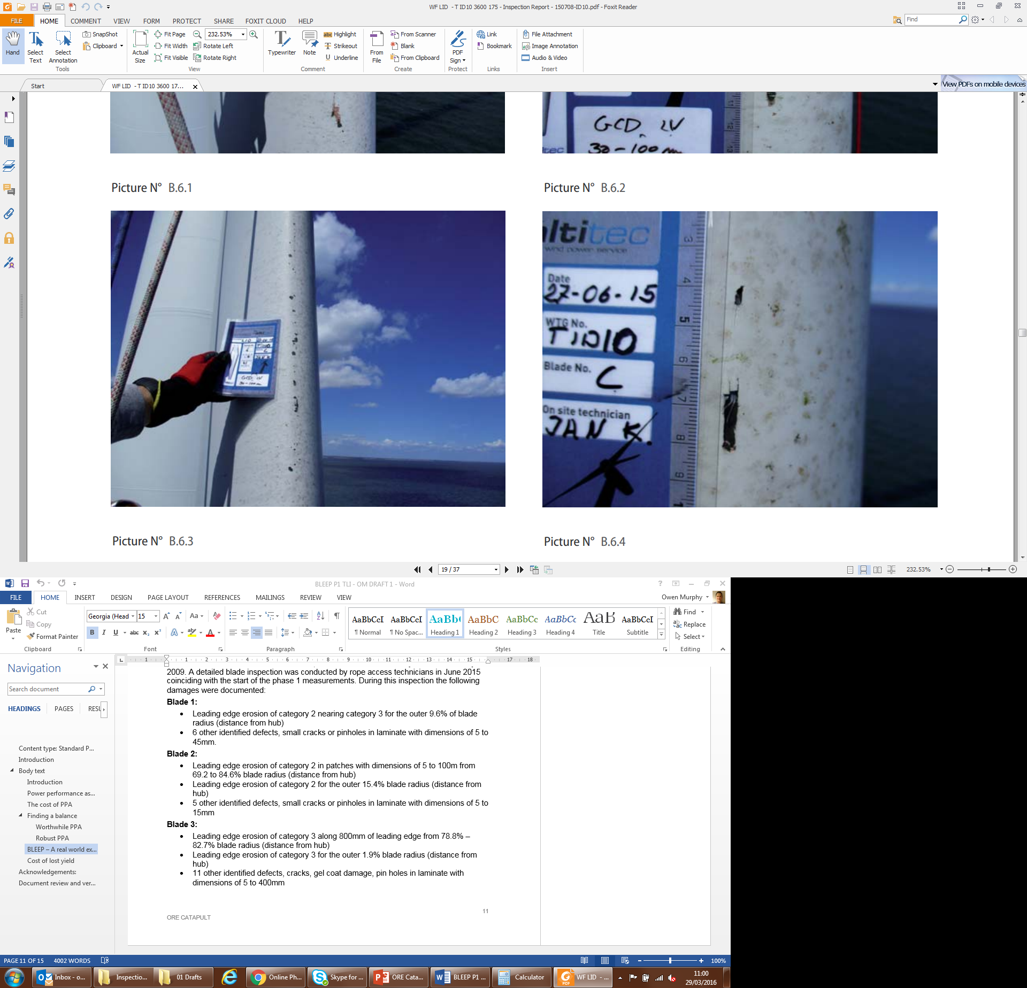
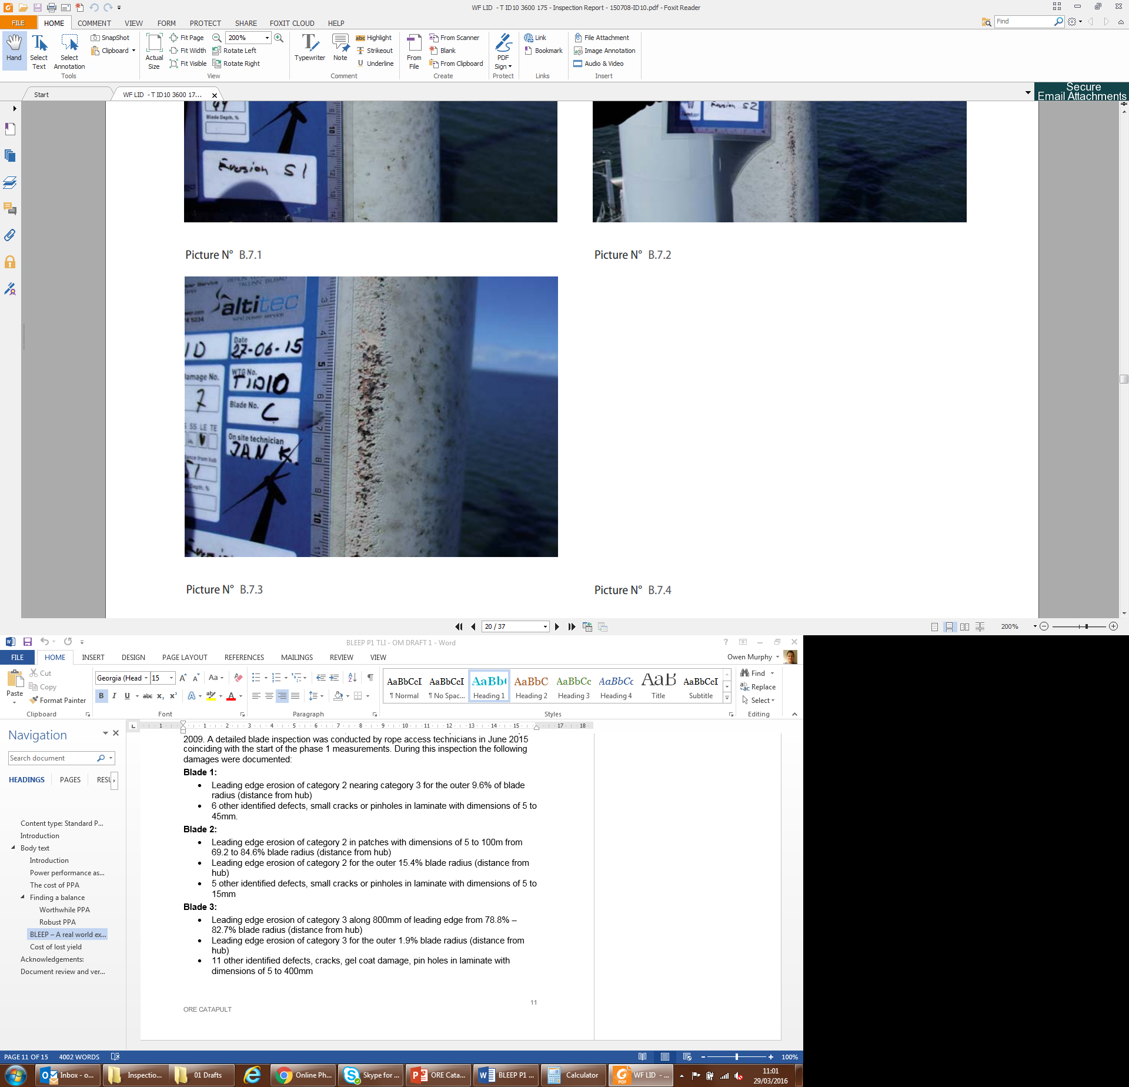
Test turbine and site
Turbine mounted Lidar
Commercial UK offshore site
Age of blades approx. 5 years at beginning of test
Reasonably consistent erosion on all blades
Not the most severe erosion we have seen

Slide 16
Sensitivity analysis

Slide 17
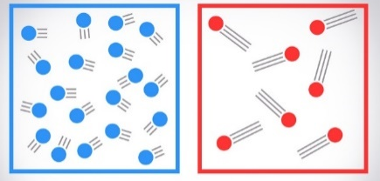
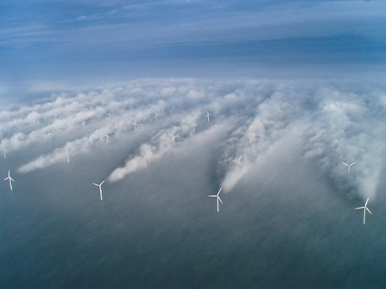
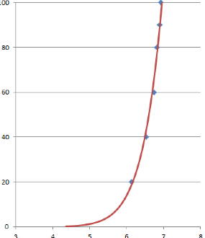
Sensitivity analysis
Definition of sufficient data for comparative before and after analysis informed by sensitivity of power curve to various parameters; only some are listed here.
Provides confidence in reducing the contribution of non-erosion parameters to performance shift.
Enables comparison of like for like test conditions across seasons.
IEC criteria (e.g. 180 hours) met after screening by sensitivity driven criteria; a large dataset.
Air density
Turbulence
Wake effects
Wind shear

Slide 18
Findings

Slide 19
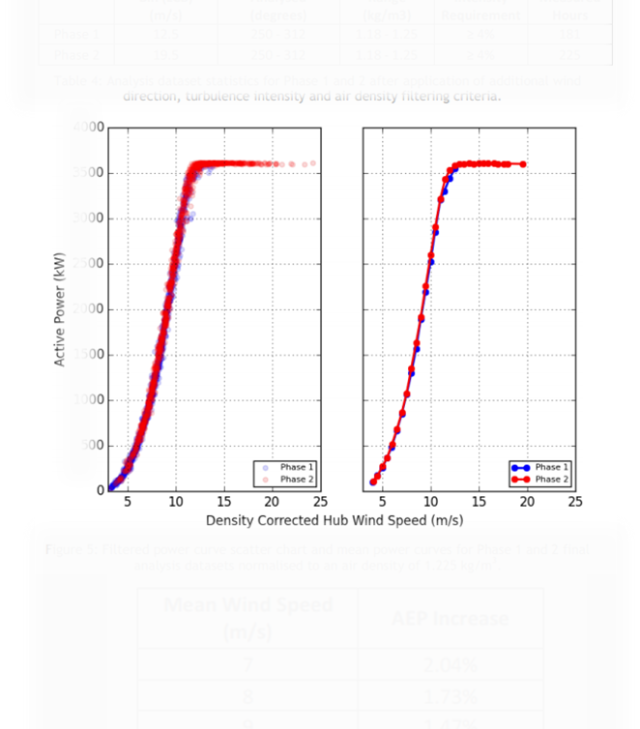
Results of measurement campaign
Positive result for methodology
Possible to detect a noticeable performance shift post blade repair
Confidence in a robust and significant result
Uncertainty has been calculated: Category B discounted in this relative comparison, Category A significantly lower than AEP shift detected
AEP impact based on non site specific wind speed distributions
However, this is only one result
It is a single level of erosion, turbine, site, and atmospheric condition
Details remain anonymised
AEP uplift post blade repair
2.04% at 7m/s
1.73% at 8m/s
1.47% at 9m/s

Slide 20
Improved decision making

Slide 21
Cost benefit understanding
Understanding

Slide 22
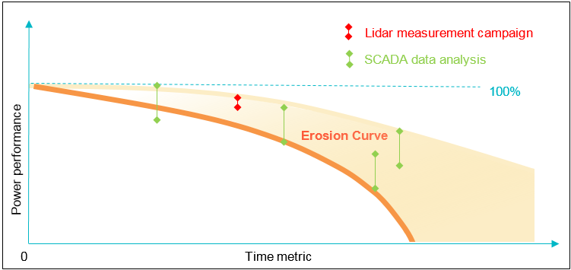
Progression of erosion
CONCEPT ONLY
Notes:
This conceptual graphic shows how additional measurements and analysis would build understanding
We have managed to put a single point on this curve
There is potential to add many more of various types

Slide 23
Linking erosion to performance
To enable evidence based decision making on intervention options such as:
Remote inspection
Rope access inspection
Light repair
Major repair
Blade removal
It is essential to link cost of action or inaction to cost of repair or inspection work
Notes:
Building on the example of the previous slide
This is what we think the concept of a performance linked erosion class could look like
A description and examples of what each erosion class looks like would need to be built up and agreed
Also an advantage in getting OEMs operators etc all using consistent language across teams/sites/equipment
It will only be possible to develop something useful like this through collaboration – a single entity cannot do it

Slide 24
Erosion class and performance loss
Erosion severity class | Blade surface coverage (%) | Variable 2 | Production loss (%)
1 | 0 - 1 | Z | 0 – 0.5
2 | 1 - 3 | Y | 0.5 – 1.2
3 | 3 - 5 | W | 1.2 – 2.3
4 | 5 - 10 | V | 2.3 – 4
5 | >10 | U | >4
CONCEPT ONLY
Notes:
Building on the example of the previous slide
This is what we think the concept of a performance linked erosion class could look like
A description and examples of what each erosion class looks like would need to be built up and agreed
Also an advantage in getting OEMs operators etc all using consistent language across teams/sites/equipment
It will only be possible to develop something useful like this through collaboration – a single entity cannot do it

Slide 25
Future work

Slide 26

Next steps
Build a fuller picture
Requiring more measurements and more analysis
Help operators understand what AEP impact erosion is having at their site
Describe how erosion impacts AEP:
At different sites
In different atmospheric conditions
On different turbine types
With different levels of erosion severity
Deliver actionable advice on how erosion impacts performance
Notes:
What we need now is to enhance the horizon of understanding
Having one result is just the beginning
There are a whole host of ways that erosion may progress differently
These would all relate closely to the cost of energy impact

Slide 27
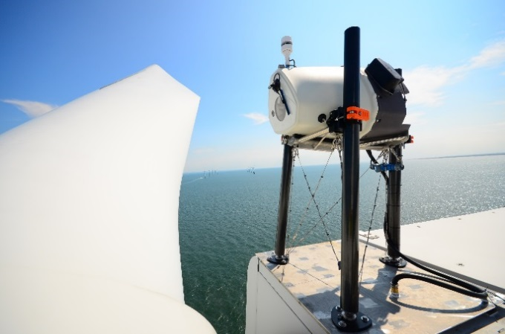
Other relevance to O&M
This kind of methodology has proven useful in study of erosion
There are other potential applications
Similar techniques applicable to other repairs or upgrades:
Control revisions
Blade add-ons
Major maintenance interventions
Yaw misalignment
Success depends on finding cost efficient ways to conduct investigations

Slide 28
Wider research

Slide 29
Wider blade erosion interest
Also actively pursuing work in related areas:
Interest in materials and coatings test methods
Independent testing capability in 2017
Fundamental research into physics of particle interaction and material damage mechanisms
Inspection and access systems
Damage classification scheme(s)
Focussed on innovation, cost of energy reduction and UK economic benefit

Slide 30
Questions?

